Slide 1

Department of Computer Science and Engineering
Length-Sensitive Summarization
PRESENTED BY
RAVULA NANDU
23475A0521
KOTA DAVID SHALEM
23475A0506
SHAIK FAHEEM AHMED
22471A05N9
Under the Guidance of,
K.V. NARASIMHA REDDY
_{M.Tech}
Assistant Professor,
Department of Computer Science and Engineering,
Narasaraopeta Engineering College (Autonomous),
Narasaraopet- 522 601.

Slide 2
OUTLINE
1. Abstract
2. Introduction
3. Literature Survey
4. Research Gaps
5. Problem Statement
6. Objectives
7. Block Diagram / Flow Diagram
8. Methodology
9. Implementation
10. Results and Analysis
11. Conclusion &Future Scope
12. References
13. Question and Answers
14. Acknowledgements

Slide 3
ABSTRACT
Abstract of the project
In today’s era of information overload, generating concise yet meaningful summaries from lengthy texts has become crucial across diverse domains.The project presents a length-sensitive abstractive text summarization framework designed to handle varying document sizes and complexities.It dynamically selects among BART, PEGASUS, and T5 transformer models, each fine-tuned on a BBC News Summary dataset subset, to generate fluent and context-aware summaries.Evaluation using ROUGE and BERT Score metrics demonstrates that PEGASUS produces the most concise outputs, BART retains contextual depth, and T5 offers strong general adaptability.This work bridges the gap between research and deployment, delivering a scalable and modular summarization solution.

Slide 4
INTRODUCTION
Brief introduction to the project
The project focuses on developing an abstractive text summarization framework using pre-trained transformer models like BART, PEGASUS, and T5.
It aims to generate concise, human-like summaries from lengthy documents while preserving semantic meaning and narrative coherence.
The system introduces a dynamic, length-sensitive model selection pipeline, ensuring that each input text is processed by the most suitable summarization model.
Motivation Behind the Project
The information explosion in digital media has created a strong need for automatic tools that can deliver quick and coherent summaries.

Slide 5

Traditional extractive approaches often fail to capture contextual depth and linguistic fluency, leading to fragmented summaries.
Advanced transformer-based architectures provide an opportunity to overcome these limitations through context-aware and fluent abstraction.
Importance and Relevance
The proposed framework supports efficient content condensation across domains like news, healthcare, education, and legal systems.
It enhances both semantic fidelity and readability, making it suitable for real-world applications requiring accuracy and coherence.
By integrating multiple models in a single pipeline, the system achieves balanced trade-offs between brevity, fluency, and factual consistency.

Slide 6
LITERATURE SURVEY
No | Title | Author | Journal Name & Year | Methodology Adapted | Key Findings | Gaps
1 | Exploring the Landscape of Automatic Text Summarizaon: A Comprehensive Survey | Bilal Khan, Zohaib Ali Shah, Muhammad Usman, Inayat Khan, Badam Niazi, 2023, IEEE Access | hps://ieeexplore.ieee.org/d ocument/10272614 | Mostly reviewed models: BERT, T5, Pegasus, etc. | Summarizes trends and models in ATS including benchmarks and challenges | Lack of language diversity in datasets and models
2 | Abstracve Text Summarizaon for the Urdu Language: Data and Methods | Muhammad Adnan Khan, Munir Ahmad, et al., 2025, IEEE | hps://ieeexplore.ieee.org/d ocument/10474013 | LSTM, Seq2Seq, Transformer | Details dataset creaon and summarization for Urdu | Scarcity of high-quality Urdu datasets
3 | A Comprehensive Review of Arabic Text Summarizaon | Asmaa Elsaid, Ammar Mohammed, Lamiaa Faouh, Mohamed Sakre, 2022, IEEE Access | hps://ieeexplore.ieee.org/d ocument/9745159 | Hybrid models, Neural Abstracve Models | Reviews Arabic-specific summarizaon methods and tool | Lacks discussion on real-world deployment
4 | MSG‑ATS: Mul‑level Semanc Graph for Arabic Text Summarizaon | Mustafa Abdul Salam; | hps://ieeexplore.ieee.org/d ocument/10632127 | Mul-level semanc graph extracve mode | Better semantic capture | No English tesng; no abstracve models
5 | The Summarizaon of Italian Tax‑Law Decisions: The Case of the PRODIGIT Project | Federico Pisanò; 2023, IEEE | hps://ieeexplore.ieee.org/d ocument/10902362 | Extractive rule based summarisation | Framework for summarizing Italian Laws | Domain-specific focus

Slide 7
LITERATURE SURVEY
Key papers related to our objectives
M. Azam & F. Ahmed, “Extractive Summarization Using Enhanced Graph Models.”
M. Salam, R. Alfarraj & M. Alweshah, “MS-GATS: Multi-Sentence Graph Attention Network for Arabic Summarization”.
M. Khan et al., “Survey of Abstractive Summarization Using Transformers.”
R. Naik et al., “EffSum: Efficient Transformer Summarization for Indian News.
A. Awais & R. M. A. Nawab, “Abstractive Urdu Summarization Using LSTM-Transformer Hybrid.”

Slide 8
Summaries of relevant literature
Azam & Ahmed — Graph-based extractive methods that improve sentence importance via enhanced centrality scores; good at coverage but weak on abstraction.
MS-GATS — Graph attention over multi-sentence units for Arabic news; shows benefits of structural context for extractive quality.
Transformer survey [5] — Comprehensive review of BART, PEGASUS, T5 and related encoder-decoder models; highlights pretraining choices and their effect on abstractive quality.
EffSum [8] — Focuses on efficiency and latency in transformer summarizers for news; demonstrates tradeoffs between speed and ROUGE performance.
LSTM-Transformer hybrid [6] — Addresses low-resource language summarization by combining recurrent and attention modules for improved coherence.

Slide 9

Key findings and relation to our project
Graph and feature-scoring methods confirm that structured extractive signals improve content coverage — we leverage this insight by treating extractive cues implicitly via model routing and preprocessing.
Transformer-focused surveys and analyses validate that model pretraining and architecture (BART, PEGASUS, T5) crucially affect fluency and factuality — this motivates our multi-model pipeline.
Efficiency studies like EffSum show latency vs. quality tradeoffs, supporting our length-sensitive routing to balance speed and fidelity.
Hybrid LSTM-Transformer approaches and multi-modal findings indicate combining model types or modalities can improve coherence—this backs our ensemble/selection strategy across models.
Feature and domain studies emphasize domain adaptation and feature fusion; we mirror this by stratified fine-tuning and preprocessing tailored to article length and complexity.

Slide 10
RESEARCH GAPS
Many prior works focus on either extractive or single-model abstractive approaches rather than a dynamic multi-model routing strategy.
Existing studies emphasize either fluency (lexical overlap) or semantic fidelity, but few implement an input-aware system that routes by length/complexity.
Scalability and real-time inference are underexplored; efficient summarizers trade accuracy for speed without adaptive selection.
Hybrid extractive→abstractive integration is limited; few systems systematically combine extractive cues with multiple abstractive backbones.
Cross-domain and long-context handling remain challenging (token limits and truncation); dynamic model selection and long-context models are needed.

Slide 11
PROBLEM STATEMENT
Problem Definition
The rapid increase of online textual data makes it challenging to extract key insights efficiently.
Existing extractive summarization models fail to maintain semantic meaning and contextual flow.
There is a lack of a unified system that dynamically adapts summarization methods based on input text length and complexity.
Significance
Enables users to access concise, meaningful summaries from large text sources quickly and accurately.
Improves information retrieval and comprehension across domains such as news, research, and education.
Enables users to select multiple models and generate the summaries.

Slide 12
OBJECTIVES
To develop a length-sensitive abstractive text summarization model using transformer architectures such as BART, PEGASUS, and T5.
To dynamically select the most suitable model based on the input document’s size and complexity.
To evaluate summarization quality using ROUGE and BERT Score for lexical and semantic accuracy.
To design a scalable and modular framework adaptable for real-world domains like news, research, and education.

Slide 13
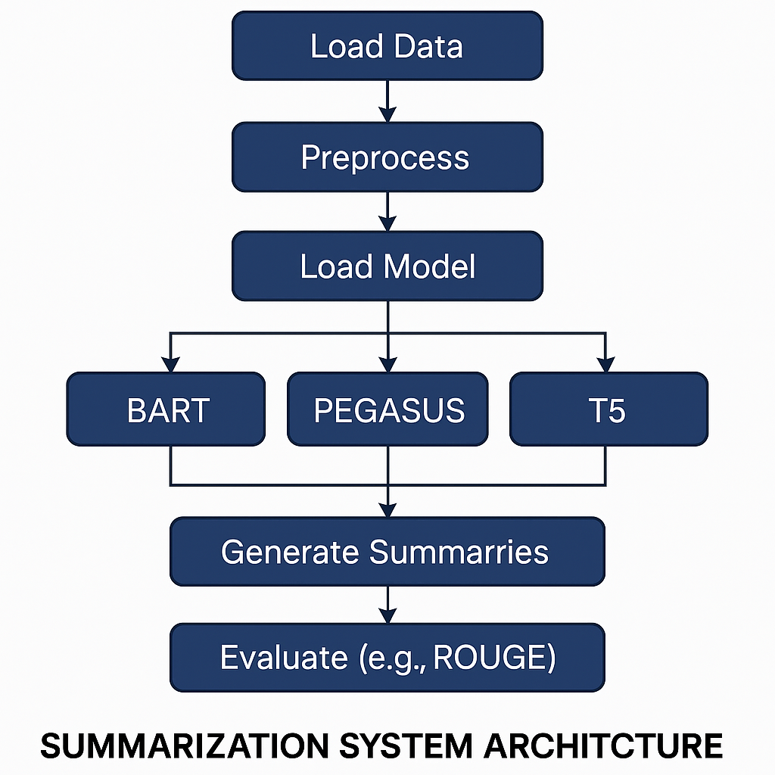
BLOCK DIAGRAM OR FLOW DIAGRAM

Slide 14
METHODOLOGY
A dynamic routing summarization framework is designed to select the most suitable model — BART, PEGASUS, or T5 — based on article length and structure.
The dataset used is a stratified BBC News Summary dataset containing 450 articles divided into short, medium, and long categories.
Preprocessing steps: lowercasing, tokenization, and removal of HTML tags, emojis, currency symbols, and extra spaces for data uniformity.
Each model is fine-tuned using the Hugging Face Transformers library, ensuring efficient GPU-based execution in Google Colab.
Evaluation Metrics: ROUGE (lexical) and BERT Score (semantic) used to assess summary quality and coherence.

Slide 15
Frameworks, Algorithms, and Tools:
Frameworks Used: Hugging Face Transformers, PyTorch, Google Colab (NVIDIA Tesla T4 GPU).
Algorithms Implemented:
BART – Sequence-to-sequence transformer combining bidirectional encoding and autoregressive decoding.
PEGASUS – Gap-sentence generation (GSG) pretraining for abstractive summarization.
T5 – Text-to-text transfer transformer reformulating summarization as a text-generation task.
Decoding Strategy: Beam Search (width = 5), Length Penalty = 1.2, No Repeat N-Gram Size = 3 to ensure fluent and non-redundant summaries.

Slide 16
IMPLEMENTATION
The project was implemented using Python and Hugging Face Transformers within Google Colab, enabling GPU acceleration and efficient fine-tuning of summarization models.
Data preprocessing, training, and evaluation were executed in modular stages for better scalability and debugging.
The summarization system dynamically selected BART, PEGASUS, or T5 models based on the input document’s token length.
Evaluation scripts were implemented to compare ROUGE and BERT Score metrics for lexical and semantic accuracy.

Slide 17
Software Specifications:
Operating System: Windows 10 / Google Colab Environment
Programming Language: Python 3.10
Libraries & Frameworks: Transformers, PyTorch, NLTK, NumPy, Pandas, Matplotlib
Development Tools: Google Colab, Jupyter Notebook, GitHub
Evaluation Metrics: ROUGE-L, BERT Score
Hardware Specifications:
Processor: Intel Core i5 or above
RAM: Minimum 8 GB (16 GB recommended)
Storage: Minimum 10 GB free space

Slide 18
Challenges Faced and Solutions:
Challenge: Model instability and memory overflow during fine-tuning large datasets.
Solution: Used gradient accumulation and reduced batch sizes to stabilize training.
Challenge: Semantic loss in generated summaries.
Solution: Introduced length penalty tuning and beam search decoding to improve fluency.
Challenge: Inconsistent evaluation results due to token limit mismatch.
Solution: Standardized token lengths and preprocessing across all models.
Challenge: Managing multiple summarization models and ensuring smooth execution when users select one or more models for comparison.
Solution: Designed a user-controlled selection interface allowing manual choice between BART, PEGASUS, and T5 models, enabling flexible testing and efficient performance comparison within a single framework.

Slide 19
RESULTS & ANALYSIS
Evaluation Methodology:
Performance evaluated using lexical metrics (ROUGE-1, ROUGE-2, ROUGE-L) and semantic metric (BERT Score F1).
Models tested on 450 BBC News articles — 150 each from short, medium, and long categories.
Hyperparameters such as beam width, repetition penalty, and length normalization were tuned individually for each model.
Results were averaged to ensure fair and consistent comparison.

Slide 20
Quantitative Comparison:
Model | ROUGE-1 | ROUGE-2 | ROUGE-L | BERTScore(F1)
BART | 43.8 | 20.5 | 40.1 | 88.7
PEGASUS | 45.6 | 22.1 | 42.5 | 89.3
T5 | 42.3 | 19.4 | 38.7 | 88.1

Slide 21
Results and Discussion:
PEGASUS achieved the best performance in both ROUGE and BERTScore, showing strong semantic fidelity and concise summarization.
BART performed efficiently for medium-length inputs but sometimes generated verbose outputs reducing ROUGE-2 precision.
T5 delivered lower ROUGE values due to input token limitations, but maintained good semantic accuracy.
Overall, PEGASUS excelled in balancing brevity, coherence, and contextual coverage.
These results highlight that model selection should depend on task requirements, not just raw metric values.

Slide 22
CONCLUSION and FUTURE SCOPE
Conclusion:
PEGASUS achieved the best summarization performance with concise and semantically accurate outputs.
BART provided contextually rich summaries but was slightly verbose on longer texts.
T5 maintained semantic consistency with stable results across varied input lengths.
Overall, the framework proved effective in benchmarking transformer models for text summarization tasks.
Future Scope:
Integrate domain-specific datasets (e.g., legal or medical texts) to enhance adaptability
Implement input-aware dynamic model routing for improved efficiency.
Apply model compression or distillation to reduce computational cost..

Slide 23
REFERENCES
M. Azam and F. Ahmed, “Extractive Summarization Using Enhanced Graph Models,” *International Journal of Artificial Intelligence*, vol. 34, no. 2, pp. 101–115, 2025.
M. Salam, R. Alfarraj, and M. Alweshah, “MS-GATS: A Multi-Sentence Graph Attention Network for Arabic Text Summarization,” in *Proc. IATMSI*, 2024
S. Rautaray, S. K. Singh, and H. Saini, “CSO–HHO Optimized Extractive Summarization Technique,” *Elsevier Expert Systems with Applications*, vol. 213, 2025.
P. Satpute and P. Kulkarni, “Hybrid TextRank with Word2Vec for Extractive Summarization,” *Springer AI Society*, 2025.
M. Khan et al., “Survey of Abstractive Summarization Using Transformers,” *ACM Computing Surveys*, vol. 56, no. 1, pp. 1–35, 2023.

Slide 24
M. Awais and R. M. A. Nawab, “Abstractive Urdu Summarization Using LSTM-Transformer Hybrid,” *IATMSI Transactions*, vol. 9, no. 2, pp. 89–100, 2024.
I. Khan, M. Rahman, and M. Almahdawi, “Arabic Text Summarization via Enhanced Lexical Cohesion,” in *Proc. IEEE NLP*, 2025.
R. Naik et al., “EffSum: Efficient Transformer Summarization for Indian News,” *Elsevier Information Processing Management*, vol. 62, 2025
M. Kadhim, H. Ali, and H. Shukur, “Feature-Based Sentence Scoring for Summarization,” *Springer Soft Computing*, 2025.
A. Elsaid, M. Alghamdi, and H. Alqarni, “Arabic Text Summarization: A Comprehensive Review,” *ACM Transactions on Asian and LowResource Language Information Processing*, vol. 21, no. 3, 2022.

Slide 25
R. Kumar and A. Joshi, “Legal Text Summarization Using Discourse and Abstraction,” *IATMSI Transactions*, vol. 10, no. 1, pp. 33–46, 2025.
A. Hegde, “Sentiment-Guided Medical Literature Summarization,” *IEEE Transactions on Computational Social Systems*, vol. 9, no. 2, pp. 200–211, 2022
S. Pisano, “Rule-Based Summarization of Italian Tax Law,” in *Proc. ` Springer LegalTech*, 2023.
R. Singh ad R. Rathi, “Clinical Summarization Using Multi-Head Attention,” *Springer Health Informatics Journal*, vol. 38, no. 1, pp. 15–27, 2025
Y. Zhang et al., “Multi-Modal Summarization of Educational Lectures,” *IEEE Transactions on Learning Technologies*, vol. 18, no. 2, pp. 123–134, 2025.

Slide 26

QUESTIONS and ANSWERS
We appreciate your time and interest.
Now we would like to open floor for questions and answers

Slide 27

ACKNOWLEGEMENTS
We sincerely thank our guide K.V NARASIMHA REDDY SIR for their valuable guidance, encouragement, and continuous support throughout the project.
We would like to thank the Head of the Department and faculty of Computer Science and Engineering, Narasaraopeta Engineering College, for providing essential resources and technical support.
We extend our gratitude to the Department of Computer Science and Engineering, Narasaraopeta Engineering College, for providing the required infrastructure and opportunity to present this work.
For any queries or further information, please reach out to:skbuddu786786@gmail.com

